Slide 1
TexT MINING Project
Neng
Chen-Ching
Mikhail

Slide 2
Table of content
Motivation.
Introduction to TF-IDF.
Use TF-IDF to identify important words.
Introduction to LDA (Latent Dirichlet Allocation).
Use LDA to extract topics of pages.
Use LDA to extract topics’ trends.
Summary.

Slide 3
MOtivation
Business reports have to be issued regularly.
Reports consist of many pages: reading them costs a lot of time.
Different companies can organize their reports in different ways.
People may only need to consider some pages related to topics of interest.

Slide 4
TF - IDF
Intended to reflect how important a word is for a document in a collection of documents.
TF – Term Frequency
IDF – Inverse Document Frequency
TF-IDF = TF * IDF

Slide 5
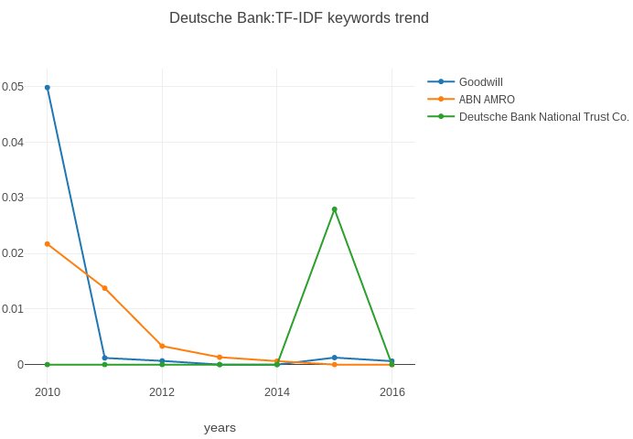
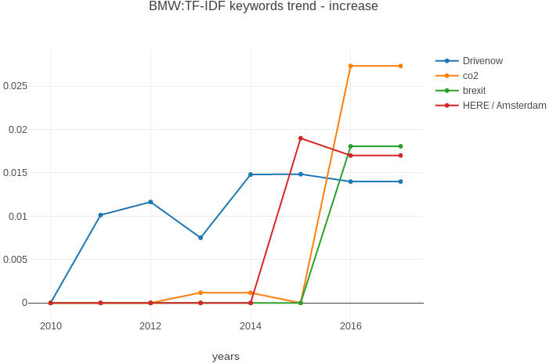
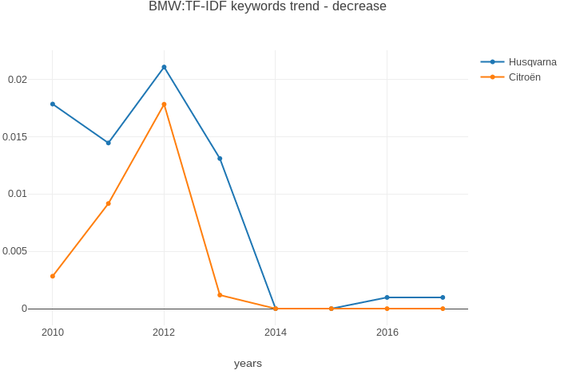
TF-IDF. Results
Simple, but working approach:
BMW reports:
CO2
Brexit
DeutscheBank:
DeutscheBank USA

Slide 6
Latent Dirichlet allocation
A mature topic modelling approach.
Well tested and well known approach.
Automatically extract topics from documents.
Can be directly applied to a new document.

Slide 7
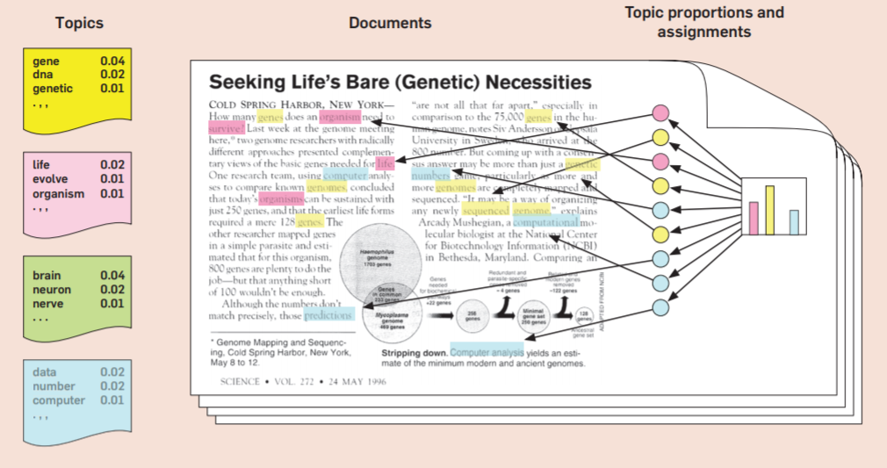
Lda. The way it Works
Each document is seen as a mixture of various topics.
Each word in the document is assigned to the topics with the certain probabilities
Each topic is seen as a set of words with assigned probabilities.
Person should assign topic-names himself, but only once.
The intuition behind latent Dirichlet allocation.
Adapted from Probabilistic Topic Models, by David M. Blei, 2012

Slide 8
Extract topics of Pages
Use machine learning technique to recommend pages highly related to topics of interest.

Slide 9
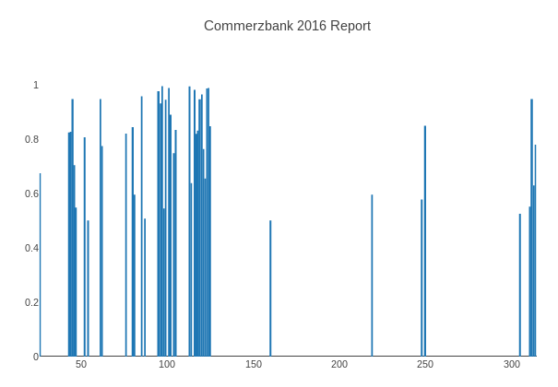


Extract topic
Topic: risk management
Approach:
Train LDA model by using 127 bank documents. Get 9 topics.
Input a new document.
For each paragraph in this document, calculate its probability of belonging to each topic.
Specify one topic, output most related paragraphs and group them to pages
Pages

Slide 10
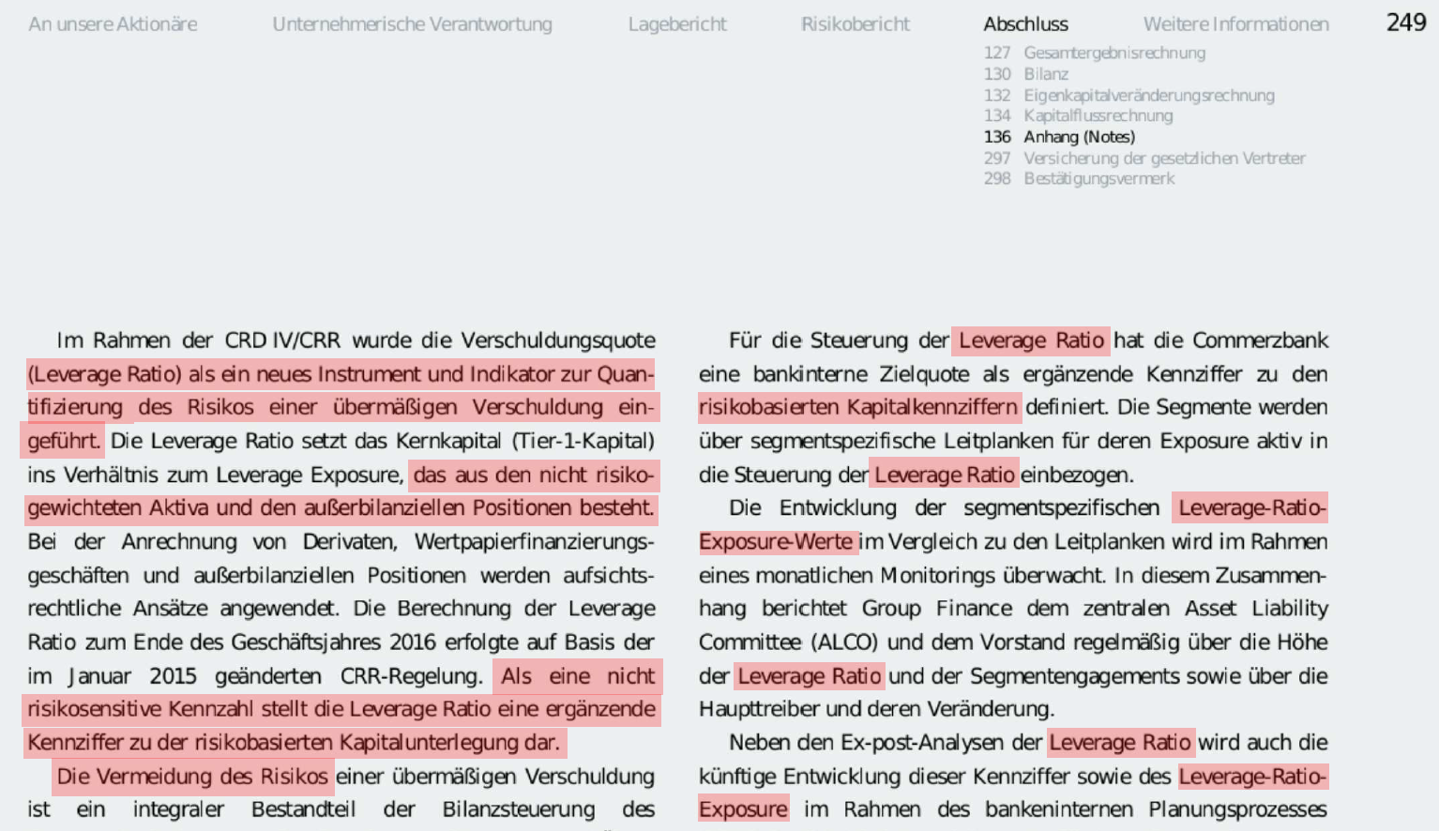
Result
CommerzBank Annual Report 2016.
Page 249.

Slide 11
Extract TOPIC trendS
Use machine learning technique to find how topic distribution evolved throughout years for certain companies

Slide 12
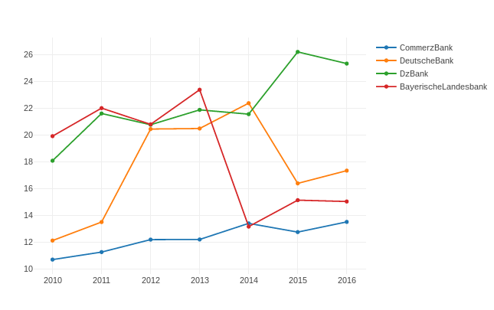
Extract Topic trends
Findings:
BayerischeLandesbank
2013 – 2014 change
DeutscheBank
2014 – 2015 change
Topic: risk management

Slide 13
Summary
TF-IDF:
Simple, but powerful for finding “hot” words in the documents
LDA:
More complicated, but allows topic detection instead of single words.
Shortages of LDA:
Topic labeling should be done manually, but only once per set of documents.

